Slide 1


SAPUI5: Layout Controls
Version 1.0, July 2015
Author Ross Hightower
Product SAPUI5
Level Beginner
October 27, 2016
Focus
Layout Control.
Public

Slide 2
FlexBox Control

Slide 3
FlexBox Control
The FlexBox control is one of a number of controls that are used to organize content in the view
The FlexBox is used to organize content vertically and horizontally and has specialized variations called HBox, Vbox, VerticalLayout and HorizontalLayout
https://sapui5.hana.ondemand.com/explored.html#/entity/sap.m.FlexBox/samples

Slide 4
FlexBox Template
<FlexBox xmlns="sap.m"
busy="false"
busyIndicatorDelay="1000"
visible="true"
height=""
width=""
displayInline="false"
direction="Row"
fitContainer="false"
renderType="Div"
justifyContent="Start"
alignItems="Stretch">
<tooltip></tooltip>
<dependents></dependents>
<items></items>
</FlexBox>
direction attribute determines whether contents are vertical or horizontal (Column or Row). The default is row.

Slide 5

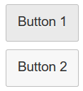
FlexBox Direction
<FlexBox>
<Button text=”Button 1” />
<Button text=”Button 2” />
</FlexBox>
<FlexBox direction=“Column”>
<Button text=”Button 1” />
<Button text=”Button 2” />
</FlexBox>

Slide 6
Other Alignment Attributes
fitContainer – Determines whether the FlexBox will completely fill its container
justifyContent – Sets the alignment along the main axis (Row or Column) as Left, Center or Right
alignItems – Sets the alignment along the cross axis as Start, Center, End, Stretch (take up the whole space along the cross axis) or Baseline (takes the first line of text in each flex item and aligns their baselines

Slide 7
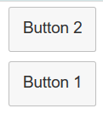
Layout Data
You can also add the layoutData control to an item in a FlexBox to modify how the item in the FlexBox is depicted
<FlexBox direction="Column">
<Button text="Button 1" >
<layoutData>
<FlexItemData order ="1" />
</layoutData>
</Button>
<Button text="Button 2" />
</FlexBox>
layoutData added to Button 1 changes the order of the buttons. The order attribute is zero based so Button 1 will be depicted after Button 2.

Slide 8
FlexItemData Attributes
growFactor – A floating point value that determines the relative amount of available space an element will take up compared to other elements. A control with a growFactor of 2 will take twice as much available space as a control with a growFactor of 1.
alignSelf – Determines how a control is aligned horizontally.
order – Determines the order of elements in a FlexBox
shrinkFactor – A floating point value that determines relative amount that an element shrinks when the screen shrinks.

Slide 9
Variations of FlexBox
HBox and Vbox are simple versions of the FlexBox control that align their contents horizontally or vertically
VerticalLayout and HorizontalLayout are similar but have fewer layout options and are found in the sap.ui.layout namespace
<VerticalLayout>
<content>
<Button text="Button 1" />
<Button text="Button 2" />
</content>
</VerticalLayout>

Slide 10
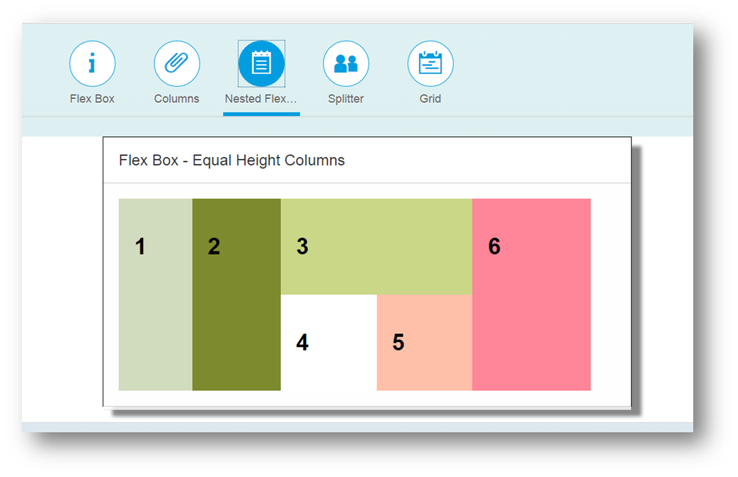
You can combine the layout controls to create complex layouts.

Slide 11
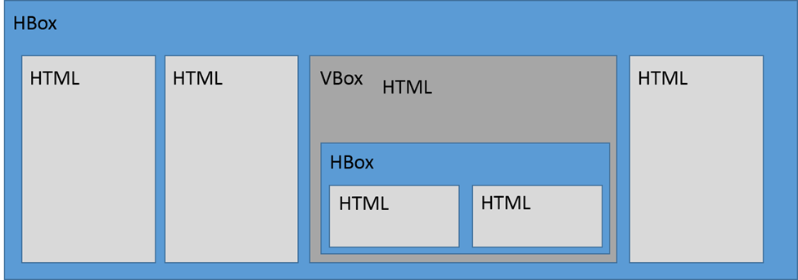

Slide 12
Grid

Slide 13
Grid Control
The Grid control is an easy way to organize the view into a responsive grid
https://sapui5.hana.ondemand.com/explored.html#/entity/sap.ui.layout.Grid/samples

Slide 14
Grid Template
<Grid xmlns="sap.ui.layout"
busy="false"
busyIndicatorDelay="1000"
visible="true"
width="100%"
vSpacing="1"
hSpacing="1"
position="Left"
defaultSpan="L3 M6 S12"
defaultIndent="L0 M0 S0"
containerQuery="false">
<tooltip></tooltip>
<dependents></dependents>
<content></content>
</Grid>
defaultSpan designates the number of columns the grid spans for large, medium and small screens (Screen is divided
into 12 columns)
defaultIndent indicates the number of columns the grid is indented from the left on large, medium and small screens
vspacing and hspacing indicates the space between rows/columns
position is the position of the grid in its container

Slide 15
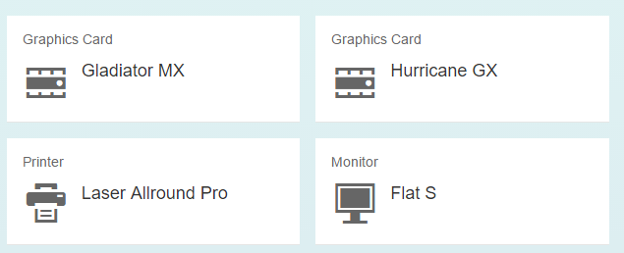
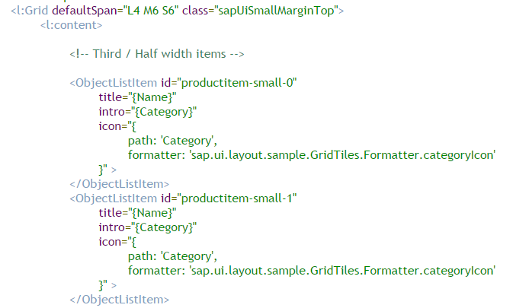
Many controls can be organized using Grids. Here ObjectListItem controls are used to create a tile display

Slide 16
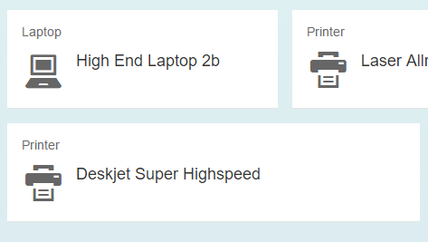
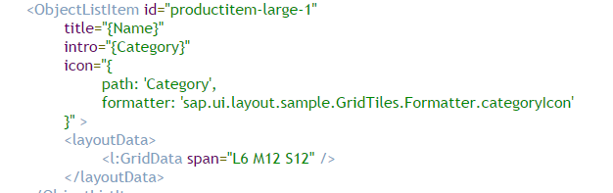
Grid Control Variations in Grid Cell Sizes
layoutData control can be used to override the default span and indents to create grid cells of different sizes

Slide 17
Other Layout Options
Attribute | Description | Usage
span spanL,spanM,spanS | The number of columns a control will span. | span=”L3 M6 S10”
Indent indentL,indentM,indentS | The number of columns a control will be offset | Indent=”L3 M6 S10”
linebreak linebreakL,linebreakM,linebreakS | If this is set to true then the control causes a linebreak and begins a new row in the grid | LinebreakS=”true”
width | The width taken within the grid. Default is 100%. | With=”50%”
visible visibleL,visibleM,visibleS | If this is set to false, the control won’t be visible for the specified screen size | visibleS=”false”
moveBackwards moveForwards | Indicates the number of columns to move a cell backwards or forwards on indicated screen sizes. | moveBackwards = “L1 M2 S3”

Slide 18
Thank you
Contact information:
Ross Hightower
hightowe@uwm.edu

